Slide 1

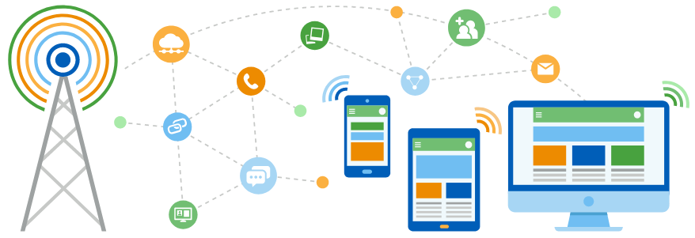
Faculty of Computing and Informatics
Department of Computer Science
IT Infrastructure Administration and Services
ITA711S
2023 - Semester 1
Event Specific Picture – behind red graphic
Chapter 1
Servers Overview

Slide 2
Outline
Overview
Types of servers

Slide 3
Prescribed Textbooks
Web Server
Proxy Server
DHCP Server
Video Server
Database Server
Application Server
File Server
Storage Server
Print Server
Mail Servers
Telnet Servers
FTP Servers

Slide 4

End

